Slide 1
Chapter 6
B2B Exchanges, Directories,
and Other Support Services

Slide 2
Learning Objectives
Define exchanges and describe their major types.
Describe the various ownership and revenue models of exchanges.
Describe B2B portals.
Describe third-party exchanges.
Distinguish between purchasing (procurement) and selling consortia.

Slide 3
Learning Objectives
Define dynamic trading and describe B2B auctions.
Describe partner relationship management (PRM).
Discuss integration issues of e-marketplaces and exchanges.
Discuss B2B networks.
Discuss issues in managing exchanges, including the critical success factors of exchanges.

Slide 4
B2B Electronic Exchanges—
An Overview
public e-marketplace (public exchange)
A many-to-many e-marketplace. Trading venues open to all interested parties (sellers and buyers); usually run by third parties. Some are also known as trading exchanges
market maker
The third party that operates an exchange (and in many cases, also owns the exchange)

Slide 5
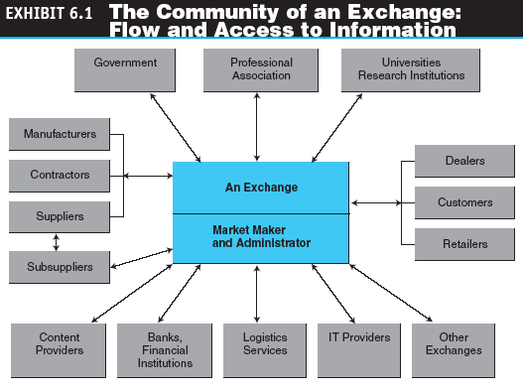
B2B Electronic Exchanges—
An Overview

Slide 6
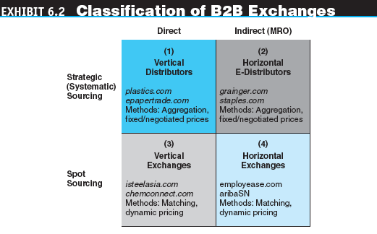
B2B Electronic Exchanges—
An Overview

Slide 7
B2B Electronic Exchanges—
An Overview
vertical exchange
An exchange whose members are in one industry or industry segment. It trades only in materials/services unique for that industry
horizontal exchange
An exchange that handles materials used by companies in different industries

Slide 8
B2B Electronic Exchanges—
An Overview
dynamic pricing
A rapid movement of prices over time and possibly across customers, as a result of supply and demand matching

Slide 9
B2B Electronic Exchanges—
An Overview
The typical process that results in dynamic pricing in most exchanges:
  A company posts a bid to buy a product or an offer to sell one
  An auction (forward or reverse) is activated
  Buyers and sellers can see the bids and offers that usually remain anonymous
  Buyers and sellers interact with bids and offers in real time Sometimes group purchasing is used to obtain a volume discount price
  A deal is struck when there is an exact match between a buyer and a seller on price, volume, and other variables, such as location or quality
  The deal is consummated, and payment and delivery are arranged

Slide 10
B2B Electronic Exchanges—
An Overview
Functions of Exchanges
  Matching buyers and sellers
  Facilitating transactions
  Maintaining exchange policies and infrastructure

Slide 11
B2B Electronic Exchanges—
An Overview
Ownership of Exchanges
  One company, usually an industry giant
  A neutral entrepreneur
  The consortium (or co-op)
Governance and Organization
  Membership
  Site access and security
  Services provided by exchanges

Slide 12
B2B Electronic Exchanges—
An Overview
Advantages of Exchanges
  Making markets more efficient, providing opportunities for sellers and buyers to find new business partners
  Cutting the administrative costs of ordering MROs
  Expediting trading processes
  Facilitating global trade
  Creating communities of informed buyers and sellers

Slide 13
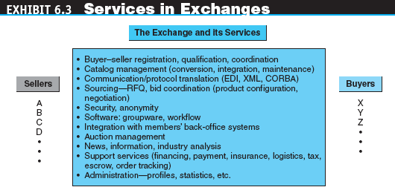
B2B Electronic Exchanges—
An Overview

Slide 14
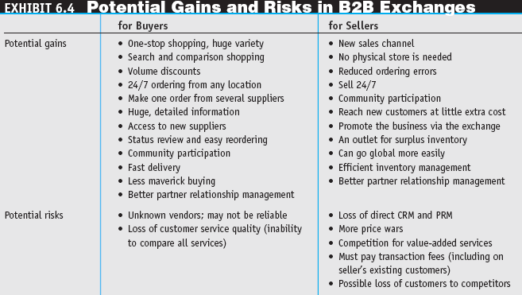
B2B Electronic Exchanges—
An Overview

Slide 15
B2B Electronic Exchanges—
An Overview
Revenue Models
  Transaction fees
  Fee for service
  Membership fees
  Advertising fees
  Other revenue sources

Slide 16
B2B Portals and Directories
B2B portals
Information portals for businesses
vortals
B2B portals that focus on a single industry or industry segment; “vertical portals”

Slide 17
B2B Portals and Directories
Directory Services and Search Engines
  Directory services can help buyers and sellers manage the task of finding specialized products, services, and potential partners
  Specialized search engines are becoming a necessity in many industries due to the information glut

Slide 18
Third-Party and Directory Exchanges
Third-party exchanges are characterized by two contradicting properties
  They are neutral because they do not favor either sellers or buyers
  Because they do not have a built-in constituency of sellers or buyers, they sometimes have a problem attracting enough buyers and sellers to attain financial viability

Slide 19
Third-Party and Directory Exchanges
market liquidity
The degree to which something can be bought or sold in a marketplace without significantly affecting its price. It is determined by the number of buyers and sellers in the market and the transaction volume

Slide 20
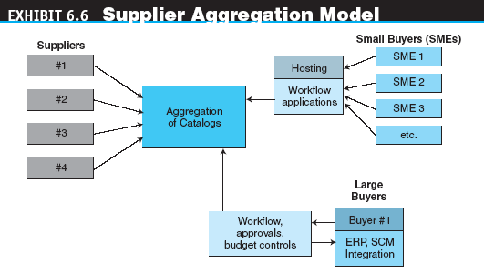
Third-Party and Directory Exchanges

Slide 21
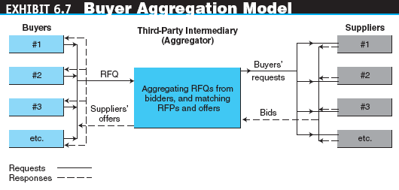
Third-Party and Directory Exchanges

Slide 22
Consortium Trading Exchanges
consortium trading exchange (CTE)
An exchange formed and operated by a group of major companies in an industry to provide industry-wide transaction services
Markets operate in three basic types of environments:
  Fragmented markets
  Seller-concentrated markets
  Buyer-concentrated markets

Slide 23
Consortium Trading Exchanges
CTEs are classified by two main criteria:
  Whether they focus on buying or selling
  Whether they are vertical or horizontal
The four types of consortia are:
  Purchasing oriented, vertical
  Purchasing oriented, horizontal
  Selling oriented, vertical
  Selling oriented, horizontal

Slide 24
Consortium Trading Exchanges
Purchasing-Oriented Consortia
  Vertical purchasing-oriented CTEs
  Horizontal purchasing-oriented CTEs
Selling-Oriented Consortia
  Selling-oriented consortia are less common than buying-oriented ones. Most selling-oriented consortia are vertical

Slide 25
Consortium Trading Exchanges
Legal Issues for Consortia
  Legal challenges for B2B consortia
  Critical success factors for consortia
    Appropriate business and revenue models
    Size of the industry
    Ability to drive user adoption
    Elasticity
    Standardization of commodity-like products
    Management of intensive information flow
    Smoothing of supply chain inefficiencies
    Harmonized shared objectives

Slide 26
Consortium Trading Exchanges
  elasticity
  The measure of the incremental spending (demand) by buyers as a result of price changing
  Combining consortia and third-party exchanges

Slide 27
Dynamic Trading:
Matching and Auctions
dynamic trading
Trading that occurs in situations when prices are changing continuously, being determined by supply and demand (e.g., in auctions)

Slide 28
Dynamic Trading:
Matching and Auctions
Matching
  The matching process may be more complex than buying and selling in regular auctions due to the need to match both prices and quantities, and many cases, quality, delivery times, and locations
Auctions
  An exchange may offer auction services as one of its many activities
  An exchange is fully dedicated to auctions

Slide 29
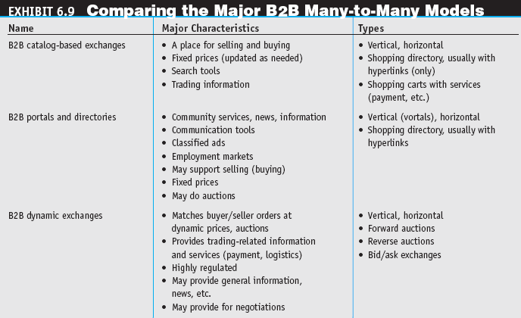
Dynamic Trading:
Matching and Auctions

Slide 30
Partner and Supplier
Relationship Management
partner relationship management (PRM)
Business strategy that focuses on providing comprehensive quality service to business partners
supplier relationship management (SRM)
A comprehensive approach to managing an enterprise’s interactions with the organizations that supply the goods and services it uses

Slide 31
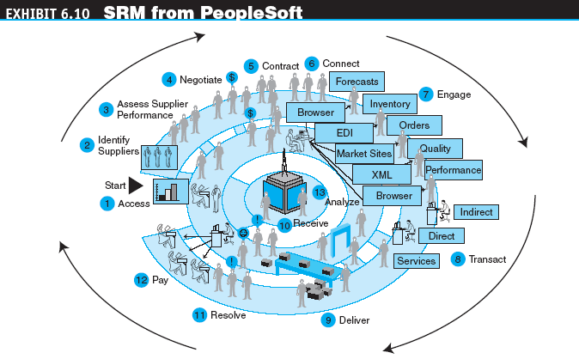
Partner and Supplier
Relationship Management

Slide 32
Partner and Supplier
Relationship Management
E-Communities and PRM
  B2B applications involve many participants: buyers and sellers, service providers, industry associations, and others, which creates a community
  E-communities connect personnel, partners, customers, and any combination of the three
  E-communities offer a powerful resource for e-businesses to leverage online discussions and interaction in order to maximize innovation and responsiveness

Slide 33
Building and Integrating
E-Marketplaces and Exchanges
Building E-Marketplaces
The Integration Issue
  External communications
    Web/client access
    Data exchange
    Direct application integration
    Shared procedures

Slide 34
Building and Integrating
E-Marketplaces and Exchanges
The Integration Issue
  Process and information coordination in integration
  Use of Web services in integration
  System and information management in integration

Slide 35
B2B Networks
Company-Centered (Private) Networks
  Provide the infrastructure for e-marketplaces
  Allow suppliers to communicate effectively and efficiently with sub-suppliers along several tiers
  Increase the visibility of buyers, sellers, and other partners along the supply chain and around the globe
  Operate on a large scale
  Foster collaboration and closer relationships among business partners
  Enable industry-wide resource planning
  Provide support services, especially financial ones for the benefit of trading partners
  Provide insurance, financial derivatives, and so on to reduce risks in certain markets

Slide 36
B2B Networks
Public Industrywide (Vertical) Networks
Transindustry And Global Networks
  Networks of exchanges (E2E)
  Global networks

Slide 37
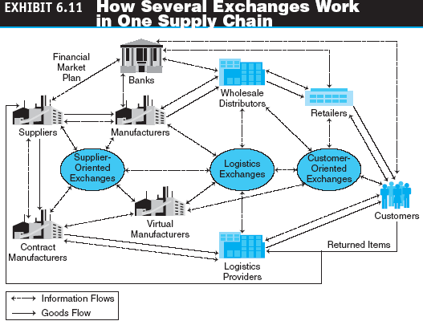
B2B Networks

Slide 38
Other B2B Implementation Issues
Private Marketplaces versus Public Exchanges
  private marketplaces
  E-marketplaces that are owned and operated by one company. Also known as company-centric marketplaces

Slide 39
Other B2B Implementation Issues
Problems with Public Exchanges
  Transaction fees
  Sharing information
  Cost savings
  Recruiting suppliers
  Too many exchanges
Supply Chain Improvers
Problems with Private Exchanges

Slide 40
Other B2B Implementation Issues
Software Agents in B2B Exchanges
  Software agents provide an efficient infrastructure to provide real-time, tighter integration between buyers and sellers and to facilitate management of multiple trading partners and their transactions across multiple virtual industry exchanges
Disintermediation and Reintermediation

Slide 41
Managing and the
Future of Exchanges
Evaluating Exchanges
Centralized Management
Critical Success Factors for Exchanges
  Early liquidity
  The right owners
  The right governance
  Openness
  A full range of services

Slide 42
Managing and the
Future of Exchanges
New Directions for B2B Marketplaces
  Critical success factors for exchanges
    Importance of domain expertise
    Targeting inefficient industry processes
    Targeting the right industries
    Brand building
    Exploiting economies of scope
    Choice of business/revenue models
    Blending content, community, and commerce
    Managing channel conflict
    Maximize the benefits for all participants
    Other factors

Slide 43
Managerial Issues
Have we done our homework?
Can we use the Internet?
Which exchange to join?
Will joining an exchange force restructuring?
Will we face channel conflicts?
What are the benefits and risks of joining an exchange?
Can we trust new trading partners?

